Slide 1
Zotero Reference Manager
UWest Library
Photo: https://pixabay.com/en/library-sky-birds-mystical-clouds-425730/

Slide 2
What is Zotero?
Zotero [zoh-TAIR-oh]
is a
non-profit, open source, free & easy to use
reference manager to help you
collect, organize, and cite
your research sources.
Download at
http://www.zotero.org
4 minute demo: https://youtu.be/MosaefbcAqg

Slide 3
Zotero App/Program
1) Left column Organizers
2) Middle column
Organizer’s Items
3) Right column Item’s Details

Slide 4
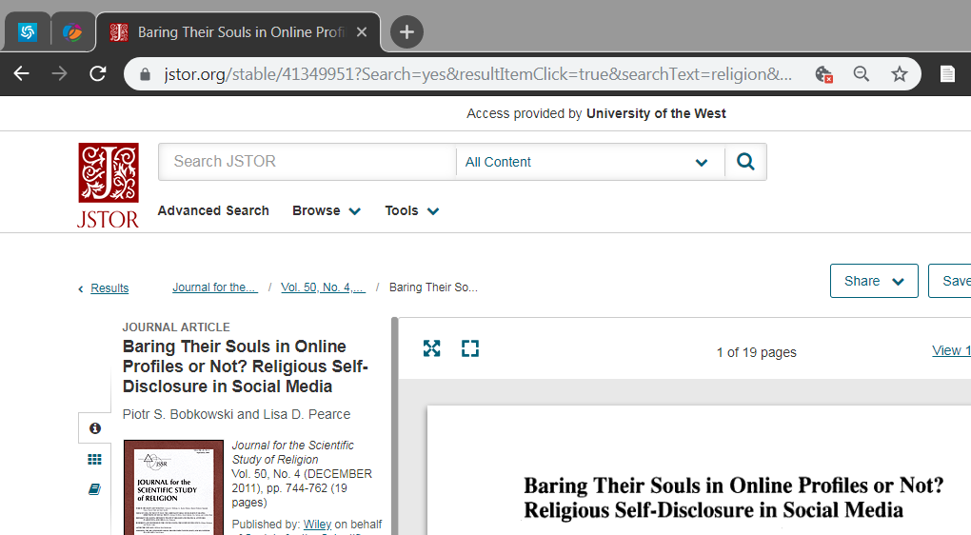
Collect Web Translators
Translates website into citation data.

Slide 5
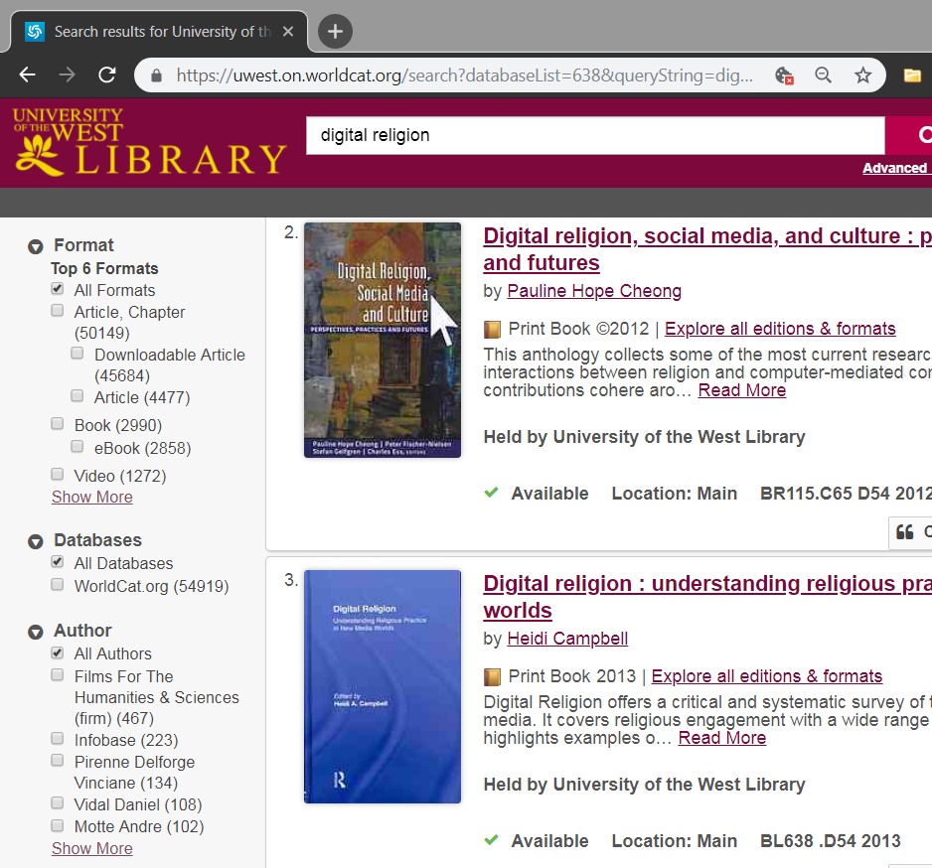
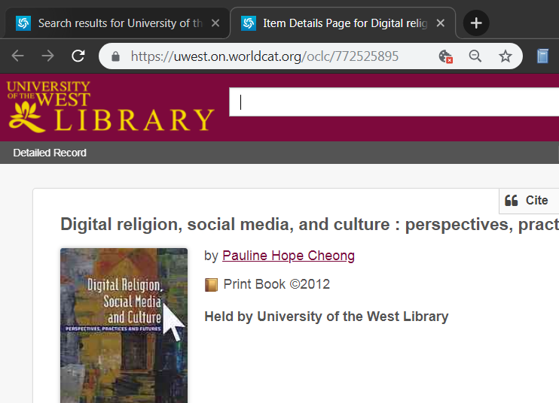
Collect Web Translators
1) Choose items of search result to add
2) Add the book on the screen.

Slide 6
Collect Magic wand
Add item via ISBN (after 1970), PubMed ID and DOI:

Slide 7
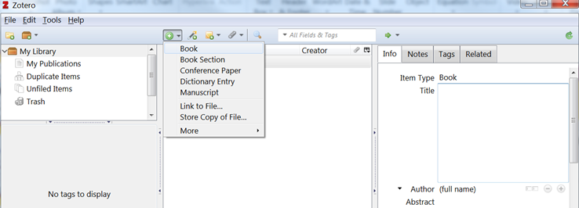
Collect Manual item
2) What is the item type?
1) Manual add.
3) Type it in.

Slide 8
Collect Item Types
Book
Book section (chapter)
Tip: You can add the Book first, then change Item Type to Book section--it will keep the book info, you can manually add the chapter title/author/page#.
Journal article
Thesis
Collection (choose from the results)
Webpage
Use rarely & if you cannot be more specific.

Slide 9
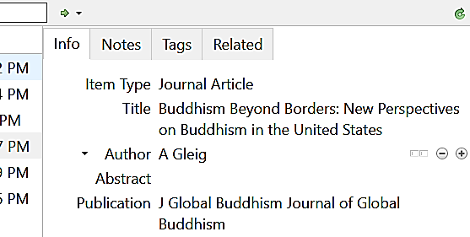
Collect Garbage in, garbage out!
Different item type = different citation rule.
A journal article found online is not a website. Item Type should still be Journal Article, but will include the URL for how you accessed it.
3) Best practice: Capitalize only proper nouns (names) in the title.
Right-click on the title text to Transform text > Sentence case. Manually capitalize the proper nouns.
Make it style neutral = used for any citation style, any language settings.
2) Web translators can add data badly. Always review & revise:
Missing period for initials.
Last and first names should reversed in two separate fields. Use one field for single-word names (Dharma names)
Journal abbreviation in the wrong field.

Slide 10
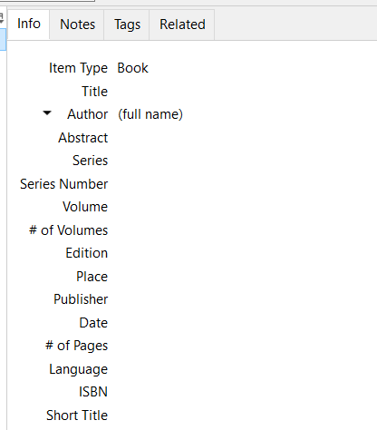
Collect Chicago Style specific issues
1) Chicago says foreign language titles should be cited in Sentence case. English titles Title Case.
Zotero assumes all capitalized words are proper nouns/names.
English, en, eng, or leave blank = Will transform title to Title Case.
Any other text = Will leave title as-is.
2) Shortened footnotes need a Short Title.
Add 1-4 title words:
Omit subtitle.
Omit initial article: A, An, The.
Do not end with a preposition/conjunction: of, to, and, in, on…

Slide 11
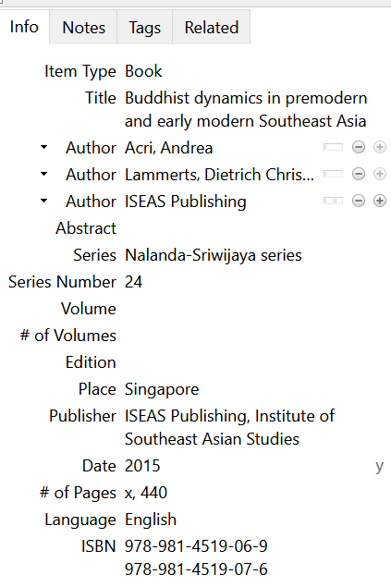
Collect Too much info
1) Unnecessary to include the publisher as the author when there are actual authors listed.
2) Series info is omitted unless it is meaningful, or is needed to distinguish generic/similar book titles.

Slide 12
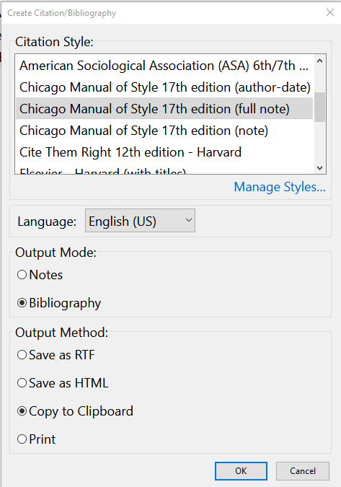
Quick bibliography
Hold the CTRL key to select multiple items. Then right-click and select Create Bibliography from Items.
2) Choose citation style & output.
Paste to a word processor, powerpoint, email, etc.

Slide 13
Collect Not working? No web translator?
Wait until the website is finished loading before clicking on the correct web translator.
Zotero, the app/program, needs to be open to add items to it.
Is Zotero waiting for your response? Press ESC (upper left) on your keyboard. Or close/open Zotero.

Slide 14
Collect Try it out: Exercise #1
https://tinyurl.com/2cnbb954

Slide 15
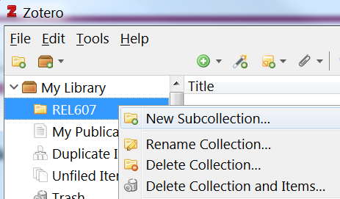
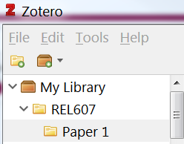
Organize Collections
1) Click on the Collections icon to organize your items. It will ask for a name. This can be anything you like.
2) Right-click on a collection to create a subcollection.

Slide 16
Organize Add to Collections
My Library will list everything, including items in the sub/collections under it.
Drag and drop items from the middle column to organize into different collections.
Non-exclusive organization:
The same item can be put into different collections.

Slide 17
Organize Tags (Labels)
(1) Click on an item and go to the Tags tab and select Add.
(2) Tags display at the bottom left column. Click on the tag to display tagged items.
Right-click on a tag to assign a color. You can drag & drop items from the middle column to the tag.
(3) This can search tags

Slide 18
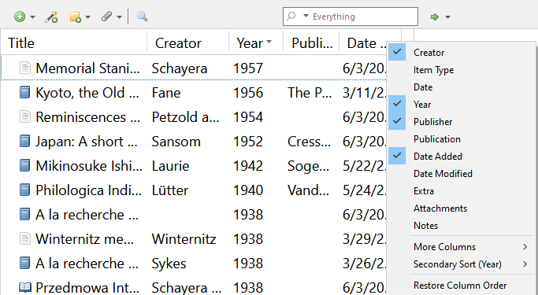
Organize Sort & Display
2) Headings can be displayed or hidden by the right-click menu in any heading.
1) Middle column can be sorted by clicking on any of the headings.

Slide 19
Organize Notes & Files
Attach your own notes.
Standalone Note—not associated with any item.
Child Note—associated with the item currently selected.
2) Attach full text PDFs, pictures, documents, URLs, any other files under each item. You can also drag and drop your computer files to a Zotero item.

Slide 20
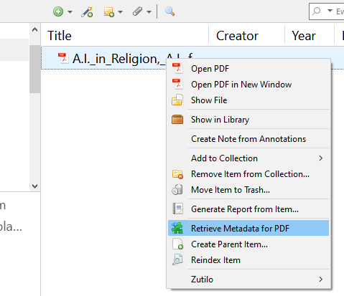
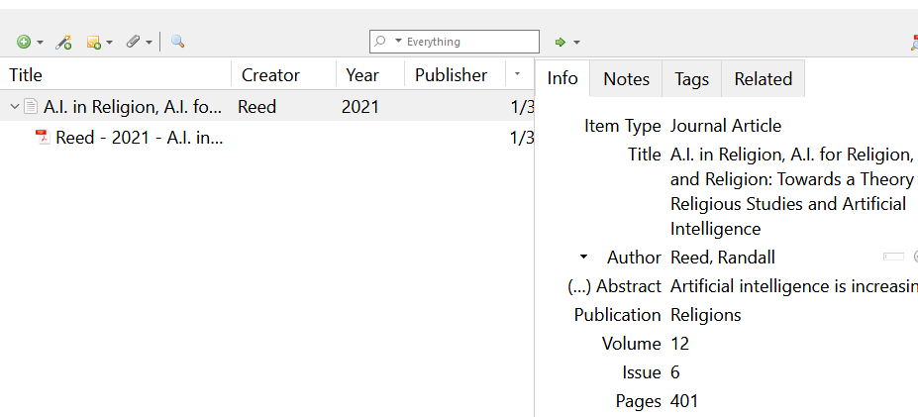
Organize Have PDF, Need Zotero Item
You cannot cite a non-Zotero item, such as PDF file. To make it citable, drop it into Zotero. It will automatically perform #1-2. If not, then right-click:
Retrieve Metadata will extract data to guess what this PDF is (Automate this feature: Top Menu > Edit > Preferences > File Handling > Automatically retrieve metadata for PDFs)
Create Parent Item will let you manually enter the citation details if #1 doesn’t work.
3) Review and revise as needed.

Slide 21
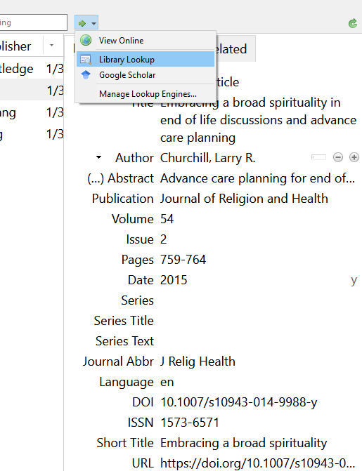
Organize Find PDF to attach
2) Library Lookup: Searches for the full text at UWest Library (Setup: Open Preferences > Advanced > OpenURL > North America > University of the West.)
Google Scholar: Searches for full text availability through other websites & related citations.
1) The web translator added the website you used—even if there’s no full text.

Slide 22
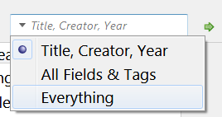
Organize Search
Zotero contents, including attached PDFs, can be searched.
1) Make sure you have selected the correct collection to search at the left column (My Library has every item).
2) Change to search Everything.
3) The results will display in the middle column.

Slide 23
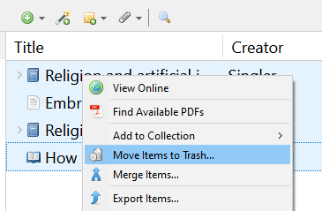
Organize Duplicate Items
1) Duplicate items can be merged if they are the same Item Type.
2) Best practice is to merge so you don’t have to do corrections, attachments, etc. twice, and there is no confusion about which one to cite.
3) To just delete instead:
Right-click on item > Move Item to Trash
Or DELETE key on keyboard.

Slide 24
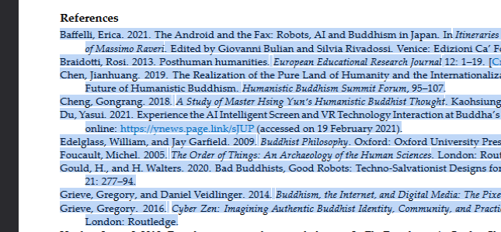
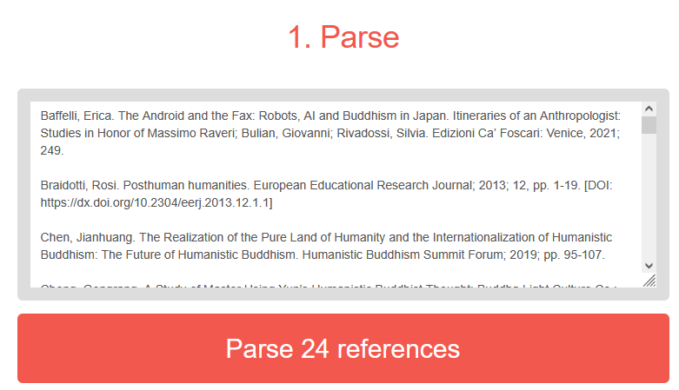
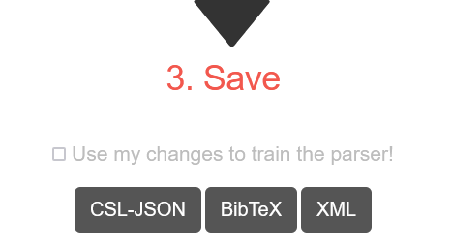
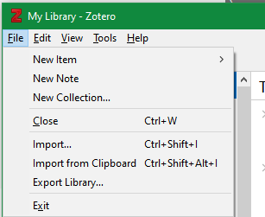
Organize Import Bibliography
Copy any bibliography.
Paste into https://anystyle.io/ to convert.
Save BibTeX file.
Import BibTeX file.
Review & revise.

Slide 25
Collect Try it out: Exercise #2
https://tinyurl.com/t5ja7v8s

Slide 26
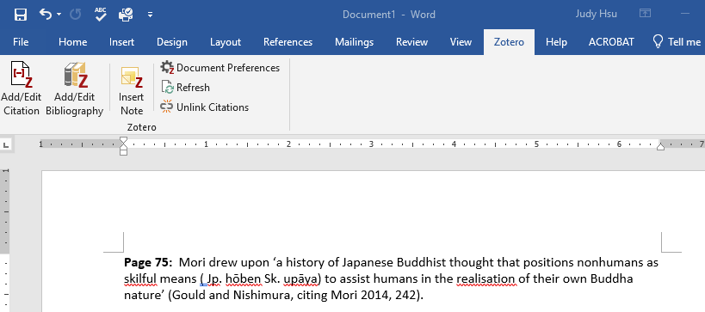
Cite Cite as you write
2) Generates bibliography of all the items used in #1.
4) (a) Change citation style.
(b) Get changes made in Zotero app.
(c) Remove Zotero’s control. Recommend saving a Zotero version before unlinking.
3) Insert text from any standalone/child note.
1) Inserts in-text citation in the style you chose for this paper.

Slide 27
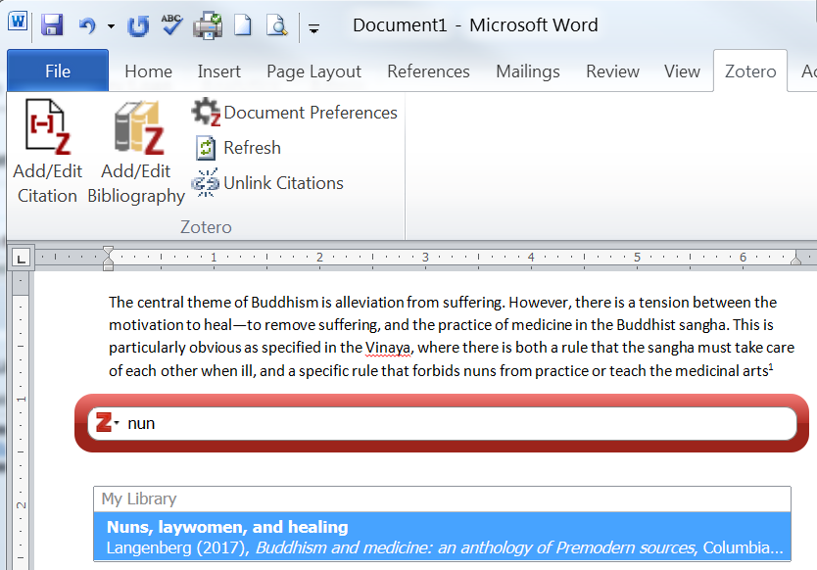
Cite Add/Edit Citation
(1) Click Add/Edit Citation. In a new document, it will ask which style you want. It will add the footnote number or parenthesis.
(2) The red search bar will pop-up.
(3) Type the title or author. It will list matching Zotero items.
Click the source.

Slide 28
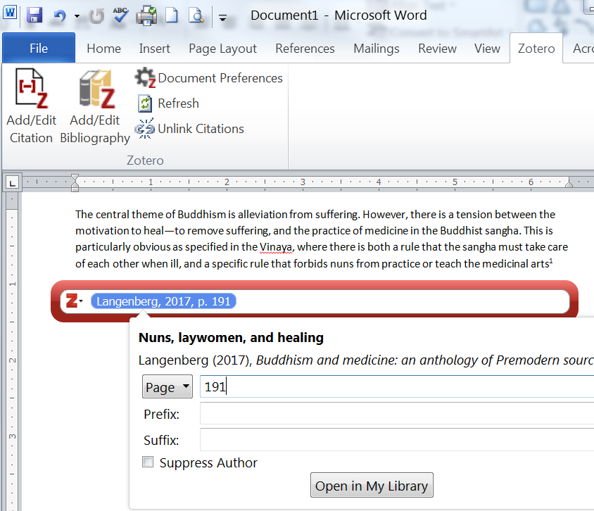
Cite Add/Edit Citation
1) To add the page#: Click on the blue item.
Type the page# and hit Enter/Return.
When there is no other source to add, hit Enter/Return again.
3) To add another item in the same footnote/parenthesis: Continuing typing in red search bar.
When all items are listed, hit Enter/Return to complete the footnote.
2) If page number is not the best identifier.

Slide 29
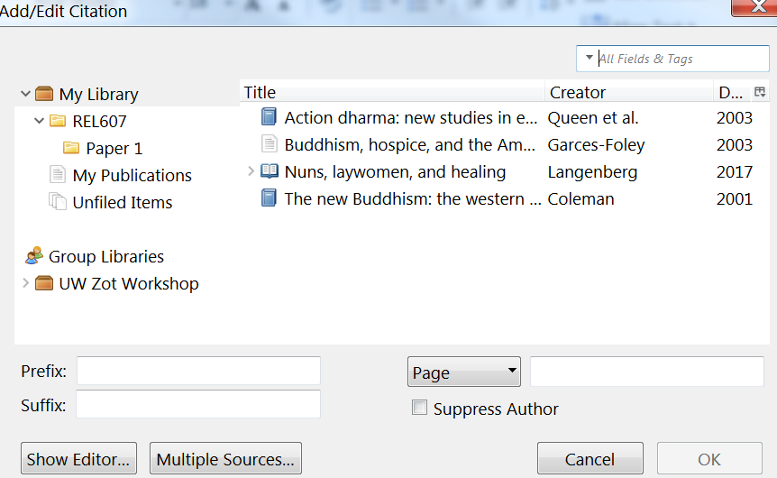
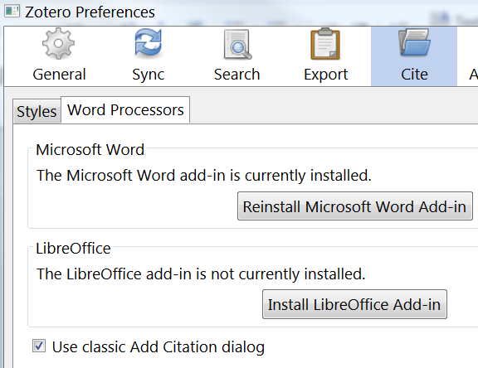
Cite Add/Edit Citation
1) To choose from the organizers, click on Z to see Classic View. Pick the item and put the page number.
3) To use Classic View all the time, go to Zotero App menu → Edit → Preferences → Cite → Word Processors:
2) Multiple items per footnote.

Slide 30
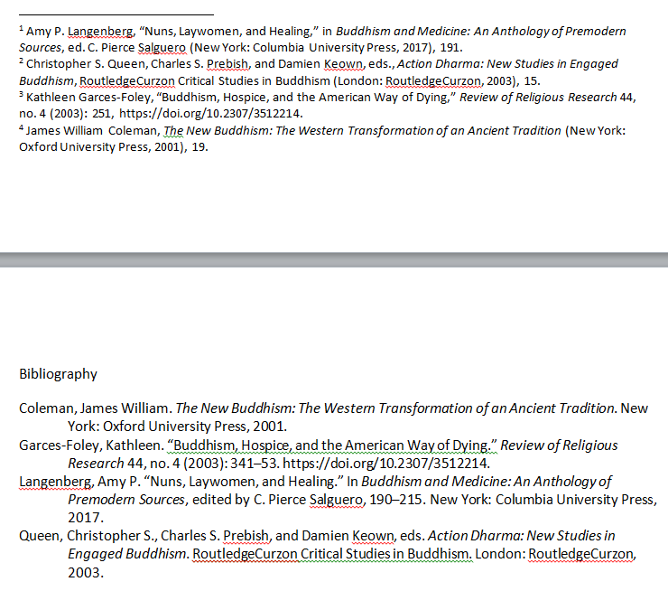
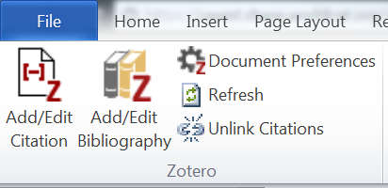
Cite Add/Edit Bibliography
This is a Chicago Style Full Note example.

Slide 31
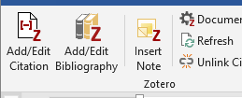
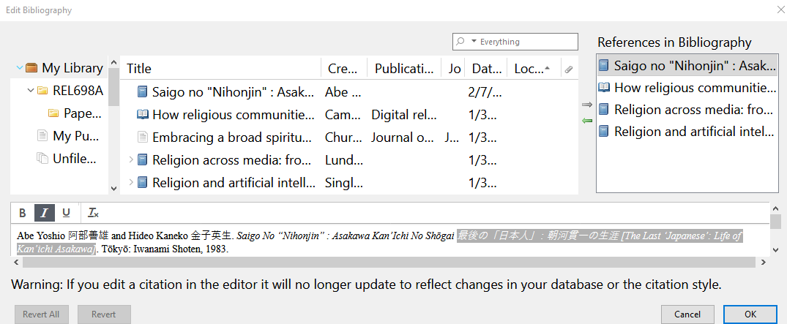
Cite Overriding Zotero
1) See something wrong in your citation: Misspelling, wrong punctuation, wrong citation rules applied, etc.
Go back to Zotero app, fix it there, then hit Refresh.
2) Add a non-cited item to the bibliography. Use the green arrow to move it over to the bibliography column.
3) To override Zotero’s output:
In the bibliography: Edit the entry through the Add/Edit interface. Example: Japanese characters in title should not be in italics.
In the citation: Edit the actual citation in the paper > Refresh > In the pop-up, hit Yes to keep your override.

Slide 32
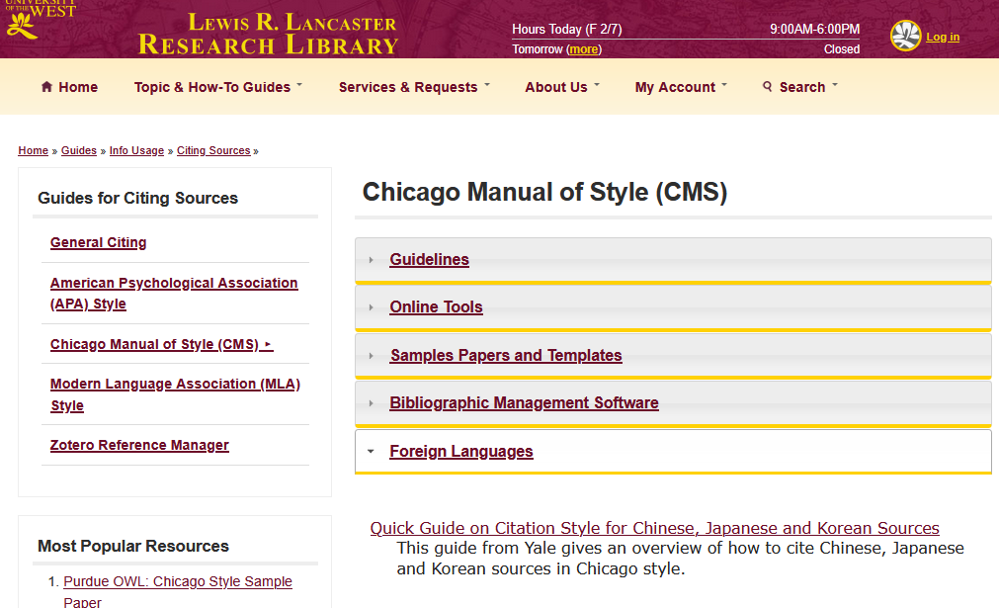
Cite Chicago Style
You are responsible for the correct footnotes and bibliography in Chicago format.
Zotero helps, it is not an excuse for bad formatting!
https://tinyurl.com/LibChicago

Slide 33
Collect Try it out: Exercise #3
https://tinyurl.com/337z9uap

Slide 34
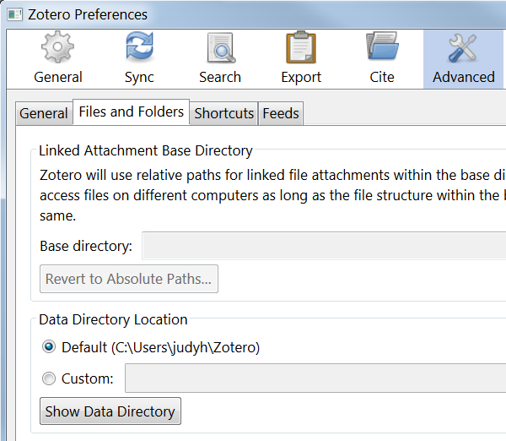
Wrap Up Sync & Manual Backup
1) Sync to multiple device & on Zotero.org: Zotero menu → Edit → Preferences → Sync. Create account at Zotero.org. Enter the same username and password.
2) Manual Backup: Zotero menu → Edit → Preferences → Advanced. Copy files from Data Directory to a backup space. To restore, reinstall Zotero and go to Data Directory. Replace all files with backup. Close/Open Zotero.
Syncing Zotero items and up to 300MB of attachments are free. Purchase more attachment space or alternatives at About Syncing.

Slide 35
Wrap Up Questions?
Presenter: Judy Hsu, Librarian.
Contact info:
Email: library@uwest.edu
Telephone: (626) 677-3319
txt: (626) 782-5591 (M-F 9-6)
Website: Lower right
http://lib.uwest.edu
@uwestlibrary

